Slide 1
STLC (Software Testing Life Cycle) Phases, Entry, Exit Criteria
Presented By- Abhishek Patel

Slide 2
Agenda
STLC Introduction
Entry and Exit Criteria in STLC
Requirement Analysis/Review
Test Planning
Test Designing
Test Environment Setup
Test Execution
Test Closure

Slide 3
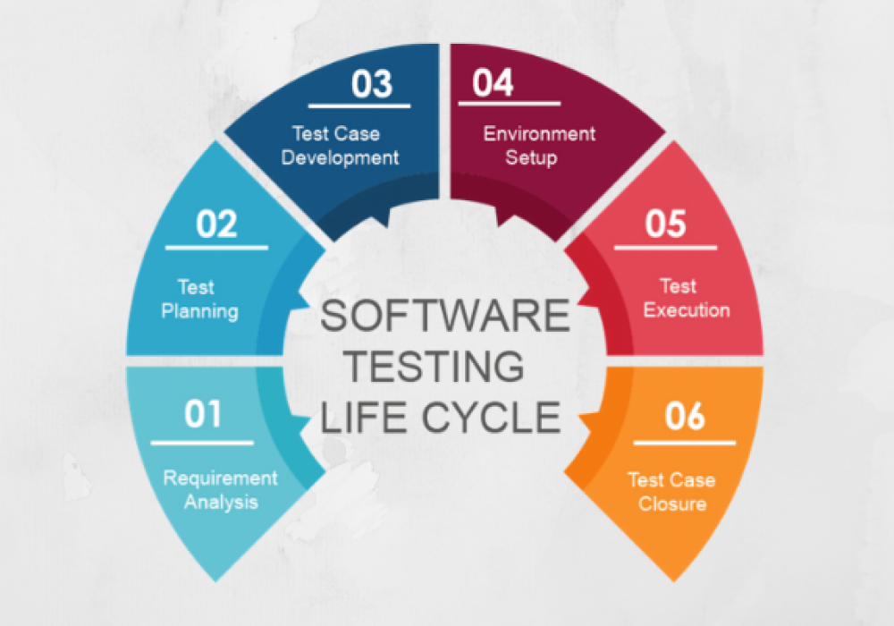
STLC Cycle

Slide 4
STLC - Software Testing Life Cycle
“Software Testing Life Cycle(STLC) is the testing process which is executed in systematic and planned manner. In STLC process, different activities are carried out to improve the quality of the product.”
Software Testing Life Cycle refers to a testing process which has specific steps to be executed in a definite sequence to ensure that the quality goals have been met.
In STLC process, each activity is carried out in a planned and systematic way. Each Phase has different goals .

Slide 5
Entry and Exit Criteria in STLC
Entry Criteria: Entry Criteria gives the prerequisite items that must be completed before testing can begin.
Exit Criteria: Exit Criteria defines the items that must be completed before testing can be concluded.

Slide 6
1. Requirement Analysis/Review
This is a very important phase in STLC
In this phase the QA interacts with the Business Analyst, System Analyst, Development Manager/Team Lead, etc. or if required the QA may also interact with Client to completely understand the requirements of the system.
During this phase the QA takes many important decisions like what are the testing types & techniques to be performed, feasibility for automation testing implementation, etc.

Slide 7
Activities:-
Identify types of tests to be performed.
Gather details about testing priorities and focus.
Prepare RTM (Requirement Traceability Matrix)
Automation feasibility analysis .

Slide 8
2. Test Planning
In this phase the QA/QA Lead/QA Manager plans for the complete testing process.
This Phase is also called Test Strategy phase. Typically in this stage , a Senior QA manager will determine effort and cost estimates for the project and would prepare and finalize the Test Plan.
This phase is very important as any small mistake in this phase can result in major issues in the project regarding time, money, efforts, etc.

Slide 9
Activities:-
Preparation of test plan
Test tool selection
Test effort estimation
Resource planning and determining roles and responsibilities.
Training requirement.

Slide 10
3. Test Designing
Creation, Review & Update of Test Cases as well as Test Scripts are done in this phase. The test cases prepared by the QA team are reviewed and approved.
Test data may also be created in this phase by the QA team if test environment is available to them.
Activities:-
Create test cases , automation scripts.
Review & baseline test cases.

Slide 11
4. Test Environment Setup
Test Environment is the actual system/environment/setup where the testing team will be testing the application. Test environment is prepared by understanding the required system architecture, software & hardware requirements, etc.
Activities:-
Understand the required architecture , environment set-up and prepare hardware & software requirement list for Test Environment.
Setup test Environment and test data.

Slide 12
5. Test Execution
The test cases which were prepared earlier are executed in this phase. In this phase, the testers test the websites. Different testing techniques as well as methods are implemented and executed on the software/application to break the system and find bugs.
Bugs are reported to the development team. The development team resolves the bugs and the system is retested to ensure that it is bug free and ready to go live.

Slide 13
Activities:-
Execute tests as per plan.
Document test results , and log defects for failed cases.
Map defects to test cases in RTM
Retest the defect fixes
Track the defects to closure

Slide 14
6. Test Closure
When the testing team is confident that all the reported bugs are resolved and the system is ready according to the client’s requirements, the software testing life cycle enters the last stage i.e.. Test Closure stage.
In this stage, evaluation is done for the complete testing cycle, test closure reports are prepared, proper analysis and documentation is done for the major or critical bugs so that such situations can be handled efficiently and effectively in future projects, etc.

Slide 15
Activities:-
Submitting STR (Software Test Result)
Submitting Test Summary report , Test Plan Document , Test Cases/Scripts etc.
Sharing experiences with the team.

Slide 16
Thank You.

